Slide 1


Dr. Stefan Coetzee
8 April 2023

Slide 2

Outline
Executive Summary
Introduction
Methodology
Results
Conclusion
Appendix

Slide 3
Executive Summary
Data Analysis:
API, Webscraping used for Data Collection
Data Processing:
Null removal, Target/Feature Engineering, Encoding Categoricals, Standardization
Predictive Analysis
KNN, SWM, Dec. Tree, Log. Reg.
EDA:
Launch from KSC LC 39
Take a large payload
Launch into ES-L1, GEO, HEO, SSO

Slide 4
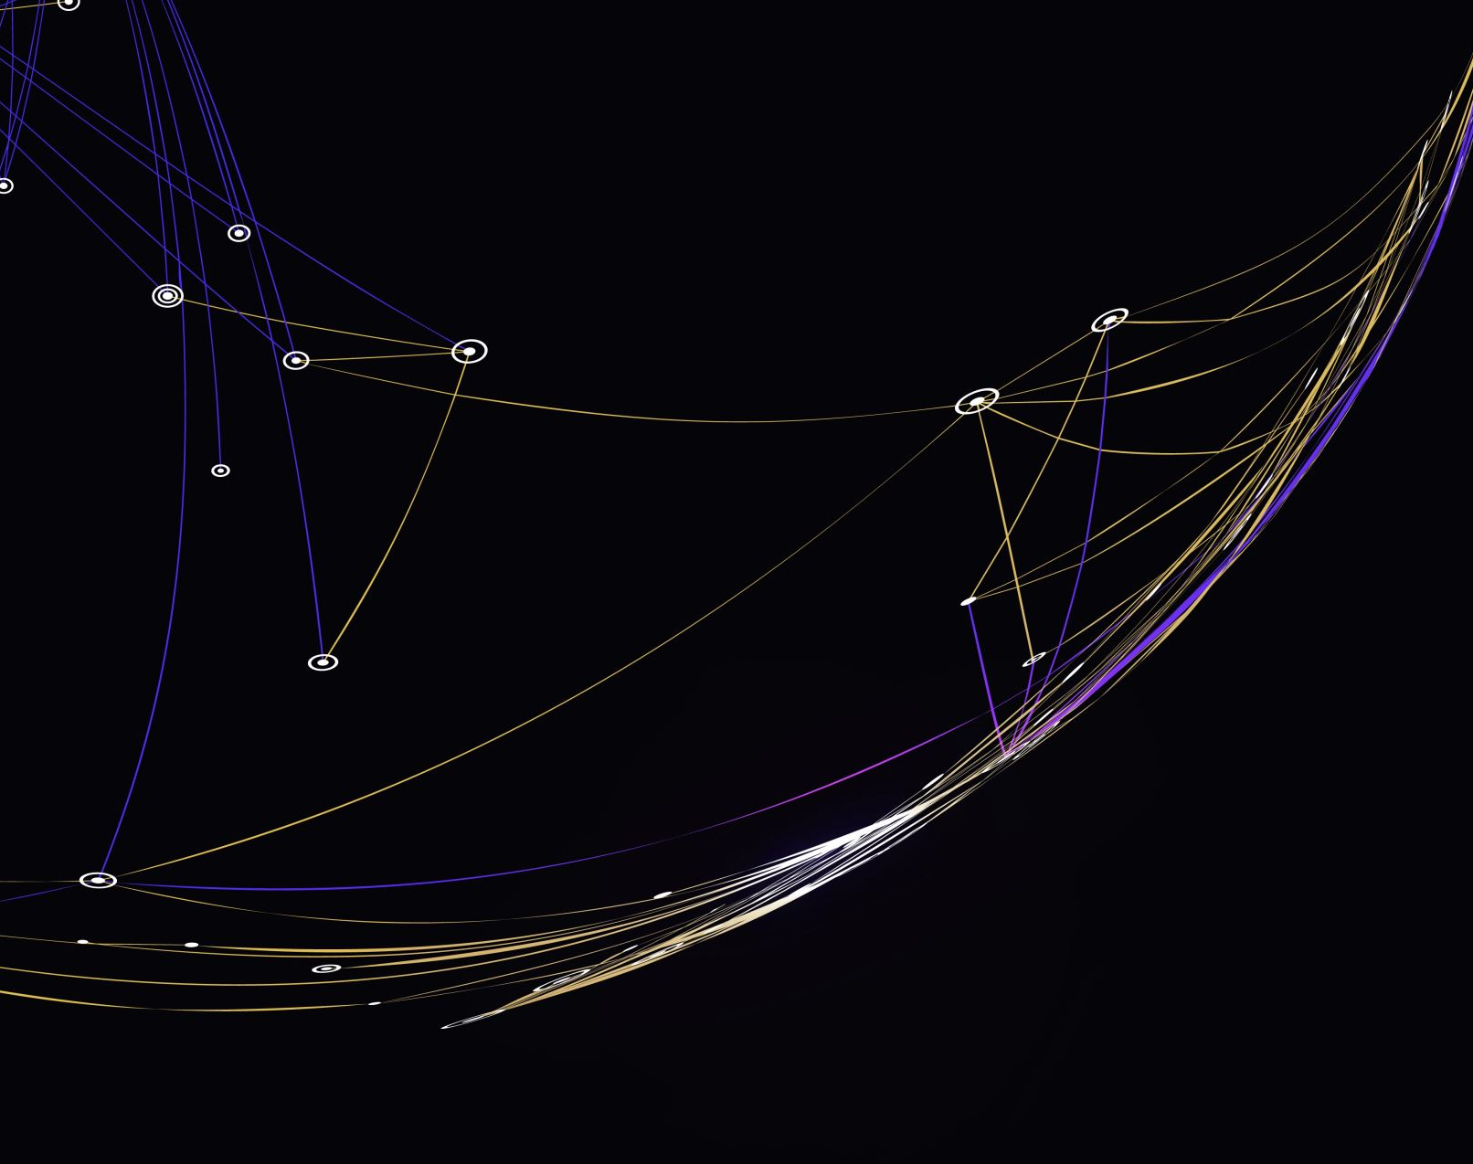
Introduction
SpaceY to enter the market as an affordable space travel company
Competition with Virgin Galactic, Rocket Lab, Blue Origin, and SpaceX making space travel affordable and accessible to everyone.
Use SpaceX’s idea to reuse stages to lower cost

Slide 5
Introduction
Our main objective will be to gather information about SpaceX and create dashboards for our team, while also predicting if SpaceX will be able to reuse a first stage using machine learning models and public information.
The success of this project will rely on our ability to accurately predict the reusability of the first stage, which will have a significant impact on the cost of each launch.
Through this project, we aim to provide valuable insights and data-driven solutions to help Space Y establish itself as a leading player in the commercial space industry.

Slide 6

Section 1

Slide 7
Methodology
Executive Summary
Data collection methodology:
SpaceX API, Webscraping Wikipedia
Perform data wrangling
Null removal, Target/Feature Engineering, Encoding Categoricals, Standardization
Perform exploratory data analysis (EDA) using visualization,Pandas and SQL
Perform interactive visual analytics using Seaborn, Folium and Plotly Dash
Perform predictive analysis using classification models
SVM, KNN, Decision Tree, Logistic Regression

Slide 8
Data Collection – SpaceX API
Additional Info
Use the ID’s in DF to get more info using:
rockets, launchpads, payloads and cores calls
API REST Call
Send API request
Parse Json
Assemble Data
Combine the data from all the calls into DataFrame
DataFrame
Convert Json to DF
Assemble Data
Combine the data from all the calls into DataFrame

Slide 9
Data Collection - Scraping
BeautifulSoup
pd.from_dict()
Parse HTML
Assemble DataFrame
HTTP
Call
Isolate HTML
Table
Requests
Get Columns and Data
Make dict.

Slide 10




Data Wrangling
NaN
1
LandingPad column removed, 41 NaN. 5 missing Payload mass replaced with Mean(Payload mass).
Target/Features
2
Outcome is target variable, mapped to 0 and 1 in col. “Class”. Relevant feature data was selected.
One Hot Encoding
3
Categorical Cols. Encoded to 0 or 1. Total encoded features = 83
Std. Test/Train Split
4
Z-score standardization, TSS at 80/20%

Slide 11


EDA with Data Visualization
Barplot
Visually Compare values
Ex: Comparing models
Time Series Plot
See a variable’s trend over time
Ex:
Success Rate over time
Categorical Plot
Explore distribution of variable
Ex:
Mission Outcome per Payload

Slide 12
EDA with SQL
SQL queries performed
Display the names of the unique launch sites in the space mission¶
Display 5 records where launch sites begin with the string 'CCA’
Total payload mass carried by boosters launched by NASA (CRS)
Average payload mass carried by booster version F9 v1.1
Date when the first successful landing outcome in ground pad was achieved
Names of the boosters success in drone ship and payload mass between 4000 and 6000

Slide 13
EDA with SQL
SQL queries performed
Total number of successful and failure mission outcomes
Booster versions which have carried the maximum payload mass.
Failed landing outcomes in drone ship, their booster versions, and launch site names for in year 2015
Rank the count of landing outcomes (such as Failure (drone ship) or Success (ground pad)) between the date 2010-06-04 and 2017-03-20, in descending order

Slide 14

Build an Interactive Map with Folium
Circles – Show the location of launch sites
Marker clusters – Cluster outcomes in a location, such as outcome per site.
Lines – Clearly show distances and directions of points of interest.
Markers – Show the positions and distances of points of interest.

Slide 15

Build a Dashboard with Plotly Dash
Pie Chart
Compare relative values
Ex:
Highest Success rates
Interactive Scatter Plot
Explore distribution of variable
Ex:
Mission Outcome per Payload

Slide 16
Predictive Analysis (Models)
Parameter
/
Cross. Val. Setup
Logistic Regression
KNN
Comparison: Accuracy
SVM
Decision Tree

Slide 17
Predictive Analysis (Parameters)
Logistic Regression | SVM |  | KNN |  | Decision Tree
C = 0.1 - 1 | C = 0.001 to 10000 |  | N = 1-10 |  | criterion: gini, entropy
L2 penalty | Kernels: |  | Algo= |  | splitter: best random
lbfgs solver | rbf | linear | ball_tree | auto | max_features: auto, sqrt
 | poly | sigmoid | kd_tree | brute | max_depth: 2*n for n in range(1,10)
 | Gamma: 0.001 to 10000 |  | P = 1, 2 |  | min_samples_leaf: 1, 2, 4 min_samples_split: 2, 5, 10

Slide 18


Slide 19
Results
Exploratory data analysis
Interactive analytics demo in screenshots
Predictive analysis

Slide 20
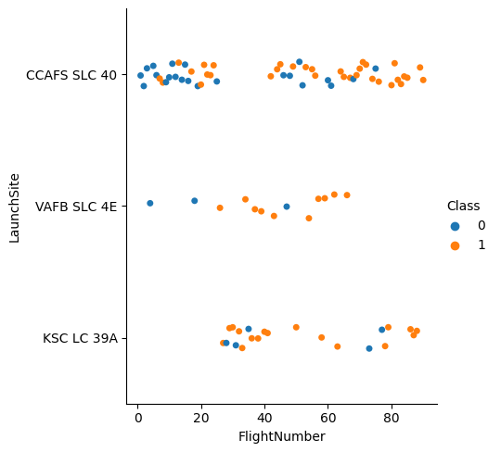
Flight Number vs. Launch Site
Initial Launches @ CCAFS SLC 40, and were mostly Unsuccessful (0)
Most Launches @ CCAFS SLC 40
KSC LC 39A most Successful (0) launches
No failed Launches after 80

Slide 21
Flight Number vs. Launch Site
Model based on CCAFS SLC – 40 may be biased.
Early launch failures are not indicative of future launches.
CCAFS SLC – 40 will predict more failures on average.

Slide 22
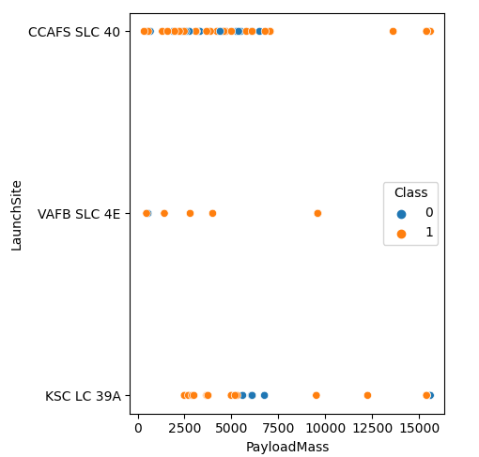
Payload vs. Launch Site
Light Rockets launched from CCAFS SLC 40 and VAFB SLC 4E.
Most failures with Payloads < 7500 Kg.

Slide 23
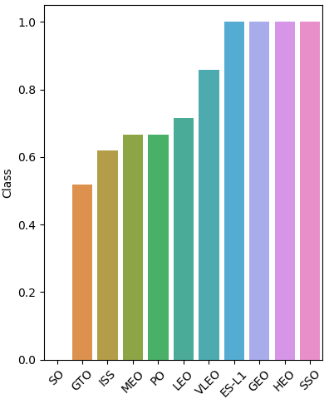
Success Rate vs. Orbit Type
ES-L1, GEO, HEO, SSO 100% success rate. Some are difficult, so impressive.
S0, GTO, and ISS worst.

Slide 24
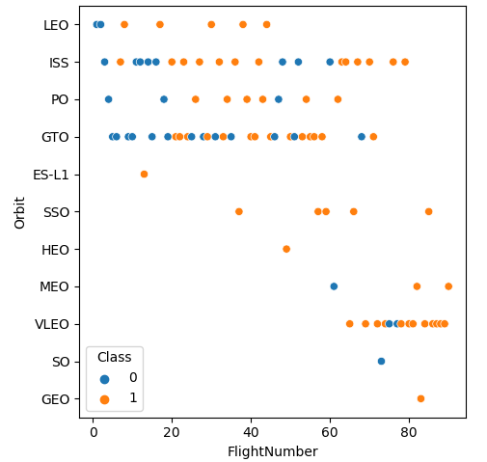
Flight Number vs. Orbit Type
Most First launches were LEO, ISS, PO and GTO orbits which are mostly low/easy.
Many VLEO which are Starlink launches

Slide 25
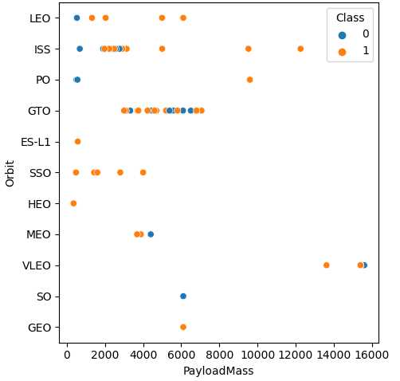
Payload vs. Orbit Type
First launches were < 2000 kg, with many failures.
16 000 kg is the largest payloads so far, Starlink which has a payload of 15-17 tons

Slide 26
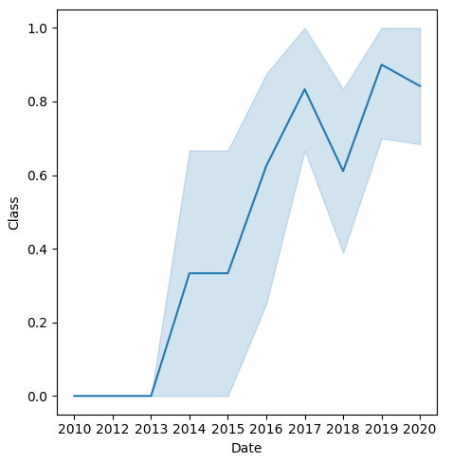
Launch Success Yearly Trend
Low success at start
50% success rate in 2015, so year window.
Current success rate > 80% after 10 years

Slide 27
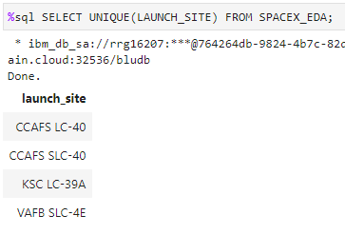
All Launch Site Names
SELECT all of the unique values in the LAUNCH_SITE column

Slide 28
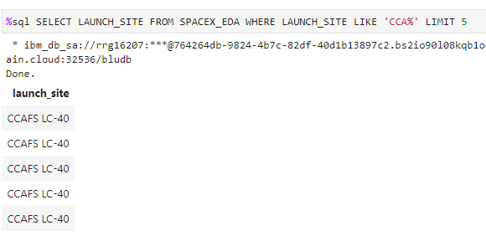
Launch Site Names Begin with 'CCA'
SELECT the LAUNCH_SITE column where the LAUNCH_SITE value starts with 'CCA', and returns a maximum of 5 rows.

Slide 29
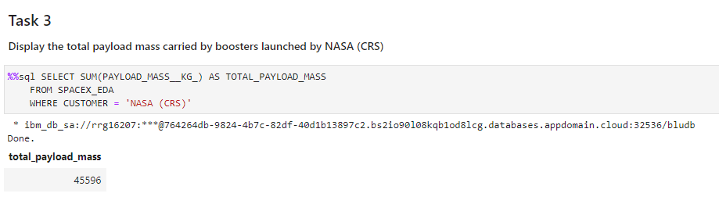
This SQL statement calculates the total payload mass of all SpaceX launches where the customer was 'NASA (CRS)', from the SPACEX_EDA table.
The SUM() function is used to add up all values in the PAYLOAD_MASS__KG_ column, and the result is renamed as TOTAL_PAYLOAD_MASS.
This SQL statement calculates the total payload mass of all SpaceX launches where the customer was 'NASA (CRS)', from the SPACEX_EDA table.
The SUM() function is used to add up all values in the PAYLOAD_MASS__KG_ column, and the result is renamed as TOTAL_PAYLOAD_MASS.
Total Payload Mass
Total payload mass of all SpaceX launches where the customer was 'NASA (CRS)'.
The SUM() function is used to add up all values in the PAYLOAD_MASS__KG_ column, and the result is renamed as TOTAL_PAYLOAD_MASS.

Slide 30
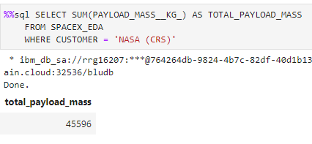
Average Payload Mass by F9 v1.1
This SQL statement calculates the average payload mass of all SpaceX launches where the BOOSTER_VERSION was 'F9 v1.1', from the SPACEX_EDA table, and renames the result as AVE_PAYLOAD_MASS.

Slide 31
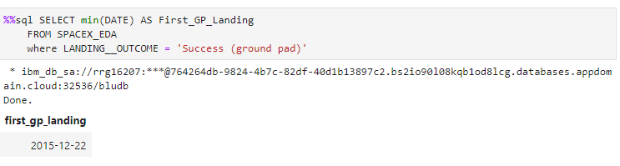
First Successful Ground Landing Date
This SQL statement finds the earliest DATE of a SpaceX launch with a successful landing on a ground pad, and renames the result as First_GP_Landing.

Slide 32
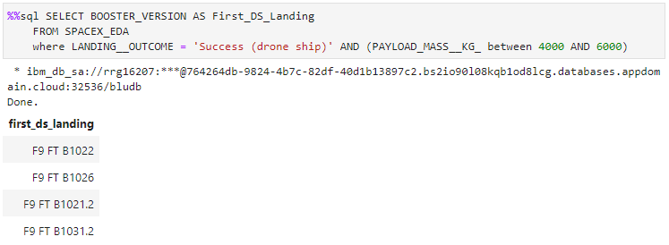
Successful Drone Ship Landing with Payload between 4000 and 6000
This SQL statement selects the BOOSTER_VERSION of all launches where the landing outcome was a success on a drone ship, and the payload mass was between 4000 and 6000 kg and renames the result as First_DS_Landing.

Slide 33
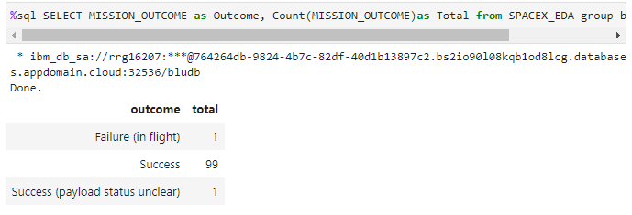
Total Number of Successful and Failure Mission Outcomes
Counts the total number of missions for each MISSION_OUTCOME and returns the two columns ‘Outcome’ and ‘Total’. The COUNT() function is used to count the number of occurrences of each MISSION_OUTCOME and the GROUP BY clause is used to group the results by MISSION_OUTCOME.

Slide 34
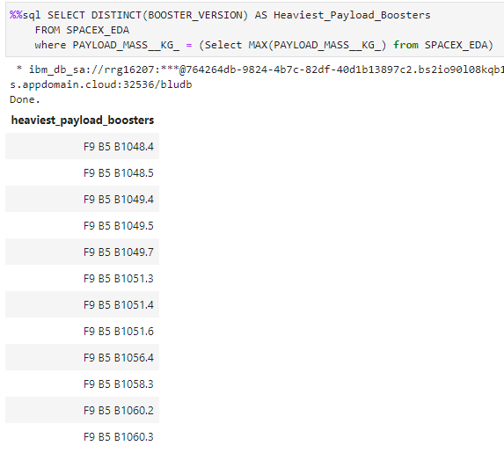
Boosters Carried Maximum Payload
SELECT all of the unique BOOSTER_VERSION with a maximum payload mass, and renames the result as Heaviest_Payload_Boosters. The subquery is used to find the maximum payload mass and the outer query is used to select the BOOSTER_VERSION associated with that maximum payload mass.

Slide 35
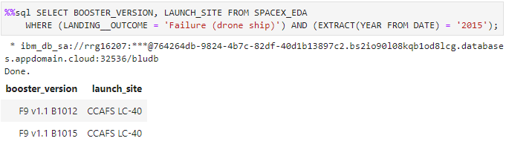
2015 Launch Records
SELECT the BOOSTER_VERSION and LAUNCH_SITE of all failed drone ship landing in 2015. The EXTRACT() function is used to extract the year from the DATE column.

Slide 36
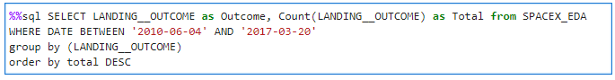
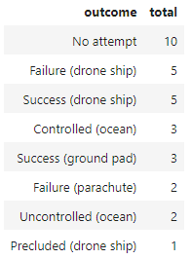
Rank Landing Outcomes Between 2010-06-04 and 2017-03-20
Counts the total number of successful and unsuccessful landing outcomes for launches that occurred between the dates and returns the results: Outcome and Total. The COUNT() function is used to count the number of occurrences of each LANDING__OUTCOME and the GROUP BY clause is used to group the results by LANDING__OUTCOME. Finally, the ORDER BY clause is used to sort the results in descending order of total count.

Slide 37

Section 3

Slide 38
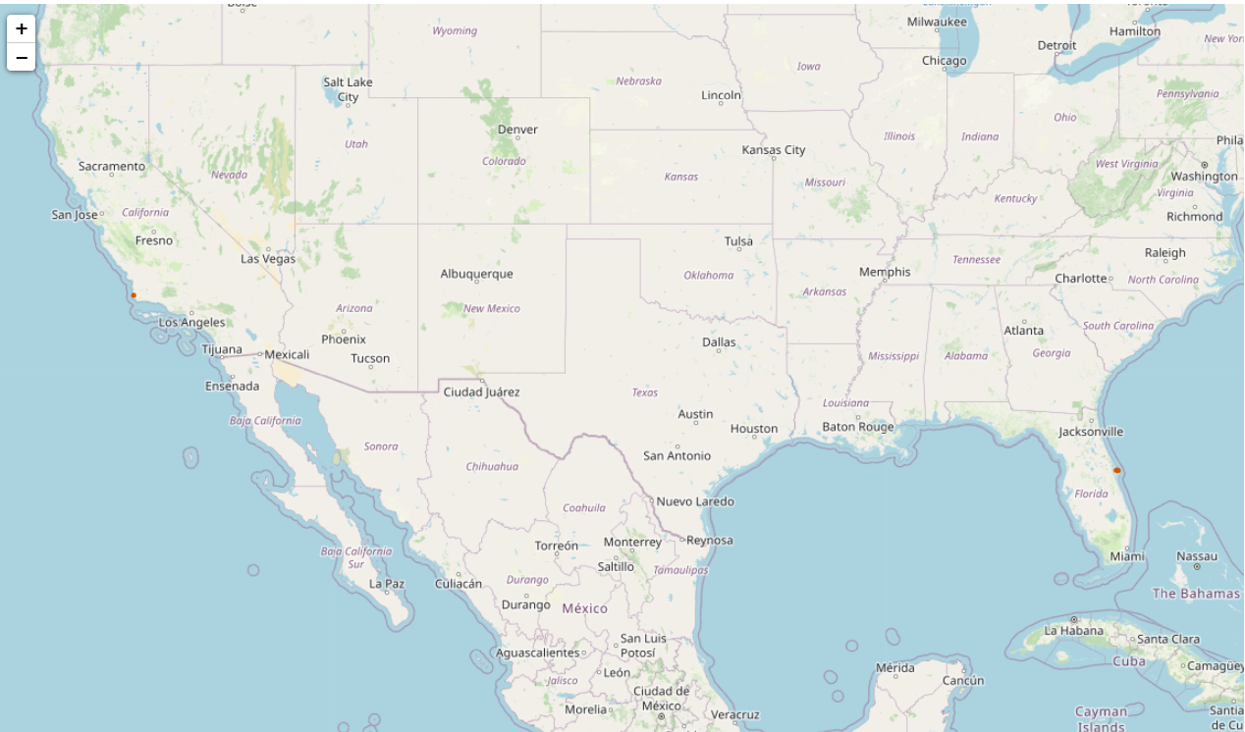
<Folium Map Screenshot 1>
KSC is on the west coast of the USA, and the rest on the east coast of Florida
All sites significantly above equator, so all launches are inclined.

Slide 39
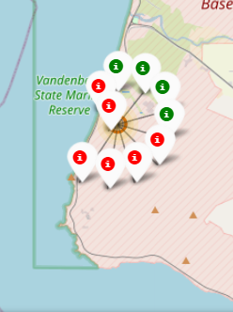
<Folium Map Screenshot 2>
The Vandanburg Site has some failed and successful launches

Slide 40
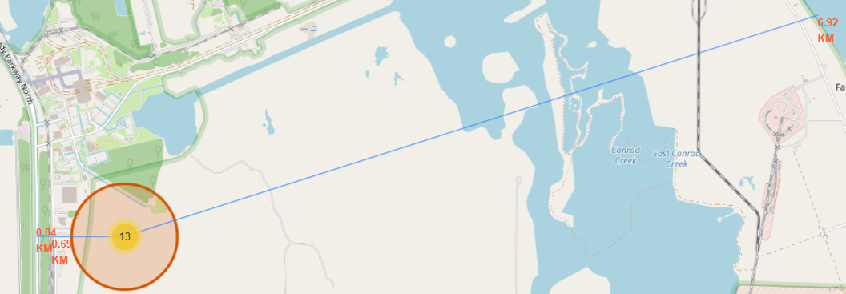
<Folium Map Screenshot 3>
The launch sites normally have infrastructure close to the site.
Rail is used to deliver parts, fuel, as shown – 0.65 km away
Road is mostly used for staff and vehicle/payload delivery 0.84 km away
Coasts are a good place to have crashes – 6.92 km away

Slide 41

Section 4

Slide 42
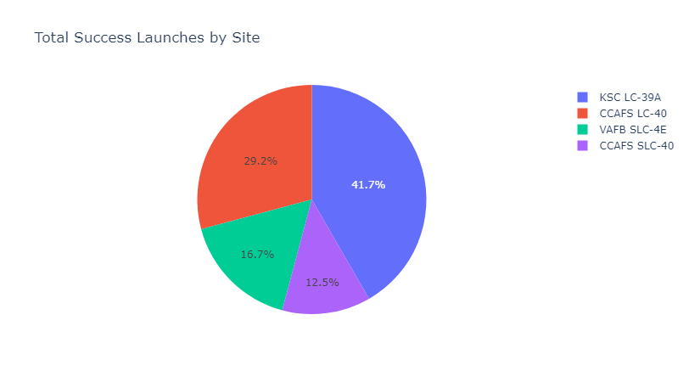
Total Successful Launches per Site
Highest success from KSC LC-39A, followed by CCAFS LC-40, with CCAFS SLC-40 the lowest success rate

Slide 43
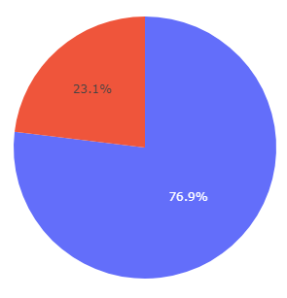
Closer look at KSC LC-39A…
KSC LC-39A has a 77% success rate.
Landed Failed

Slide 44
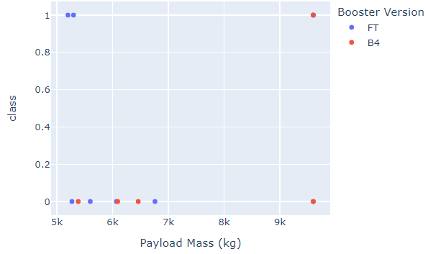
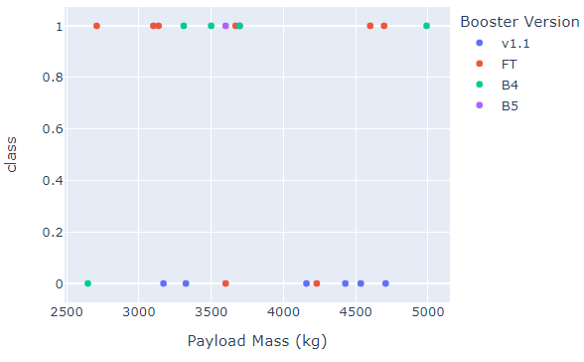
Payload vs. Success Rate
FT version most failures
V1.1 most successful
Most success when Mass > 5000 kg
Least success when Mass < 5000 kg

Slide 45

Section 5

Slide 46
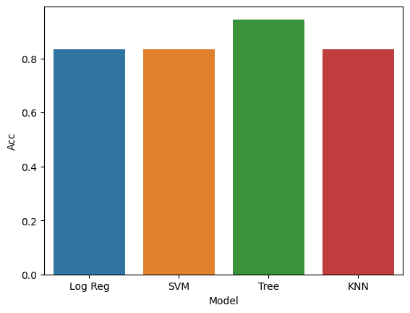
Classification Accuracy
Visualize the built model accuracy for all built classification models, in a bar chart
Find which model has the highest classification accuracy

Slide 47
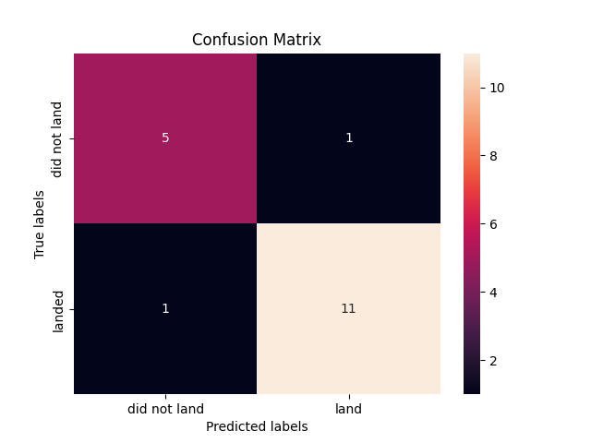
Confusion Matrix
False Negative result in significant loss of asset, so should try to improve.
Larger data set may fix
False Positives will require some further inspections, so not that serious.
True Neg.
False Pos.
False Neg.
True Pos.

Slide 48
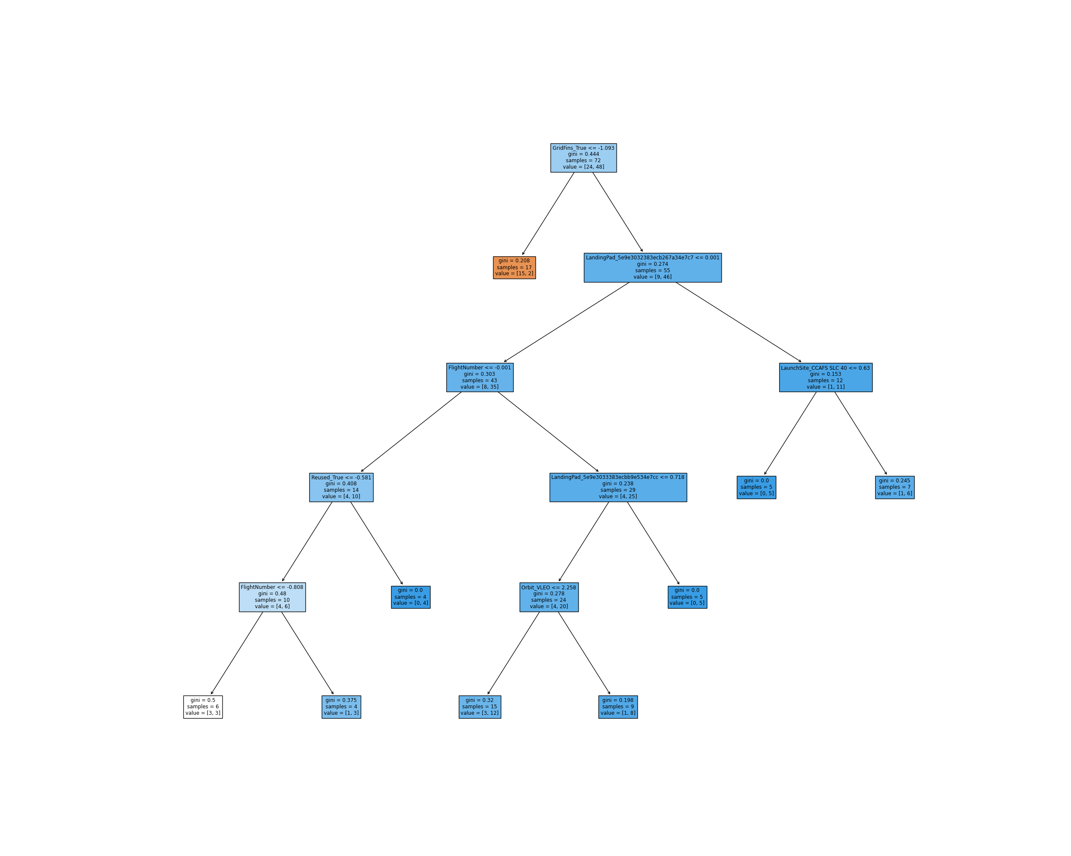
Deeper look into the Tree…
Show the confusion matrix of the best performing model with an explanation
GridFins deployed or not is a strong indicator of success with a Gini Impurity of 0.444 on all samples.

Slide 49
Deeper look into the Tree…
The CCAFS SLC – 40 is high on the Decision Tree, but has a relatively low impurity. While the bias is there, its effect is limited.

Slide 50
A note on Trees…
Decision Trees are dependent on the first branches chosen.
Many model fits resulted in Out of Sample Accuracies of 0.83, 0.88, 0.77. Perhaps a random forest may be more applicable.
Different Environments such as Jupyterlab(local), Skills Network Labs, and Watson studio resulted in different results. This is likely due to the version of sklearn. Version 1.0 brought some changes to Trees, which may lead to different results.

Slide 51
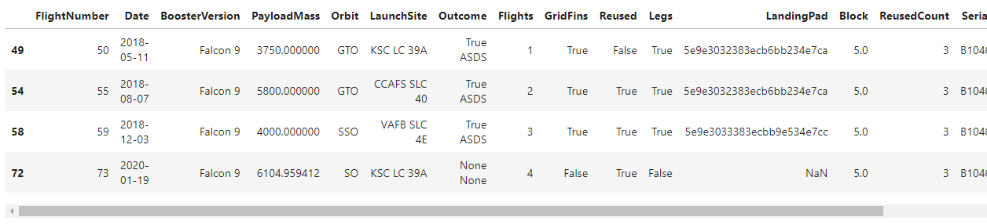
Model Improvement
From this view, Flight 73 is an example of a failed flight.
The view shows that booster B1046 launched four times, and the last time, exploded at T+00:01:36, and was unable to deploy its fins, so GridFins = False. Video.
GridFins is a dependent variable. A flight that doesn’t get an opportunity deploy the Grid fins before failing is reported as False, but it should be None.

Slide 52
Conclusions
High success:
Launch from KSC LC 39
Take a large payload
Launch into ES-L1, GEO, HEO, SSO
Model can be improved:
Mine failure causes (unstructured) from API data and categorize
Mine web searches of launch on a specific date to get more failure data.
Test/Remove Landing site variables
Reclassify GridFins to True(deployed), False(not deployed) and
None (when not tried to deploy, but failed mission)
Best Model:
Decision Tree
Gave insight into most important variables

Slide 53
Appendix
Github Project Page:
https://github.com/Spookperd/IBMCertificate/tree/main/Capstone%20Project
Flight 73
https://www.youtube.com/watch?v=ARIZnaMXTEU&ab_channel=NASA

Slide 54


